Slide 1

Tricks & Tips for You and Your Student
UCF Society of Women Engineers
Mystery Design 2017

Slide 2
Topics of this Workshop
Step-by-step guide for preparing for college
Getting your student involved
Tests and their tricks
Scholarships
Florida’s Bright Futures Program
College and beyond…

Slide 3
About Kelsie
Senior in Industrial Engineering
Minor: Computer Science
President of SWE at UCF Member of the Burnett Honors College, former member of the Programming Team
Interned at Lockheed Martin through the CWEP program and Cummins, Inc.
UCF Provost Scholar

Slide 4
About Michaela
Junior in Computer Engineering
Secretary of SWE and former Outreach Chair
Interned at GE Transportation last summer in Melbourne, FL
UCF Provost Scholar

Slide 5
Start Preparing NOW
It’s never too early to start preparing for college
College acceptances can be SUPER competitive so you should learn how you can help your student stand out!
In essence, your student will eventually have to build a “college resume”
Look at class options (like Pre-calculus)

Slide 6
Start Talking About It
Talk with your guidance counselor about career options and the education required for those careers
Talk about saving and paying for college
Talk with friends, teachers, counselors and most importantly, your kids about college

Slide 7

SWENext is a way to become part of the Society of Women Engineers as a student under the age of 18
You get:
Up-to-date information about outreach events hosted by SWE
A catalog of available scholarships for engineering school offered by SWE and partner organizations.
Eligible to participate in a quarterly webinars, where engineers from various disciplines discuss the work that they do.
Resources and activities for families and educators
A SWENext council where girls can influence the direction of this program

Slide 8
Clubs
To start a club, you must have a SWE member as an advisor
Any educator can join SWE for a reduced rate as an Educator Member ($20)
Clubs are eligible for:
Continuing Education Units (CEUs)
Program Development Grants
Reduced registration fees for SWE’s Annual Conference and events like the Invent it. Build it. program
SWE’s daily blog, All Together
The Award-winning SWE Magazine

Slide 9
Freshman and Sophomore Years
Participate in extracurricular activities and find niche
Explore internships and apprenticeships
Enroll in a summer enrichment program
Take the PSAT to prepare for the SAT (10th grade)
National Merit Scholarship opportunity
Start getting community service hours for Bright Futures

Slide 10
Florida’s Bright Futures Scholarship Program
Requirements:
Be a Florida resident and a U.S. citizen or eligible non-citizen
Earn a standard Florida high school diploma or equivalent
Be accepted by an eligible Florida public or independent postsecondary education institution, within 3 years of high school graduation
Be enrolled for at least 12 semester credit hours
Not have been found guilty of, or plead nolo contendere to, a felony charge
Apply for a scholarship from the program by high school graduation

Slide 11
Other Scholarships
Some schools automatically consider students for merit-based scholarships
Many website databases list scholarships for your students
Start applying for them early – most have deadlines associated with them
Fill out the FAFSA every year for your student to be qualified for government financial aid, grants, and fellowships

Slide 12
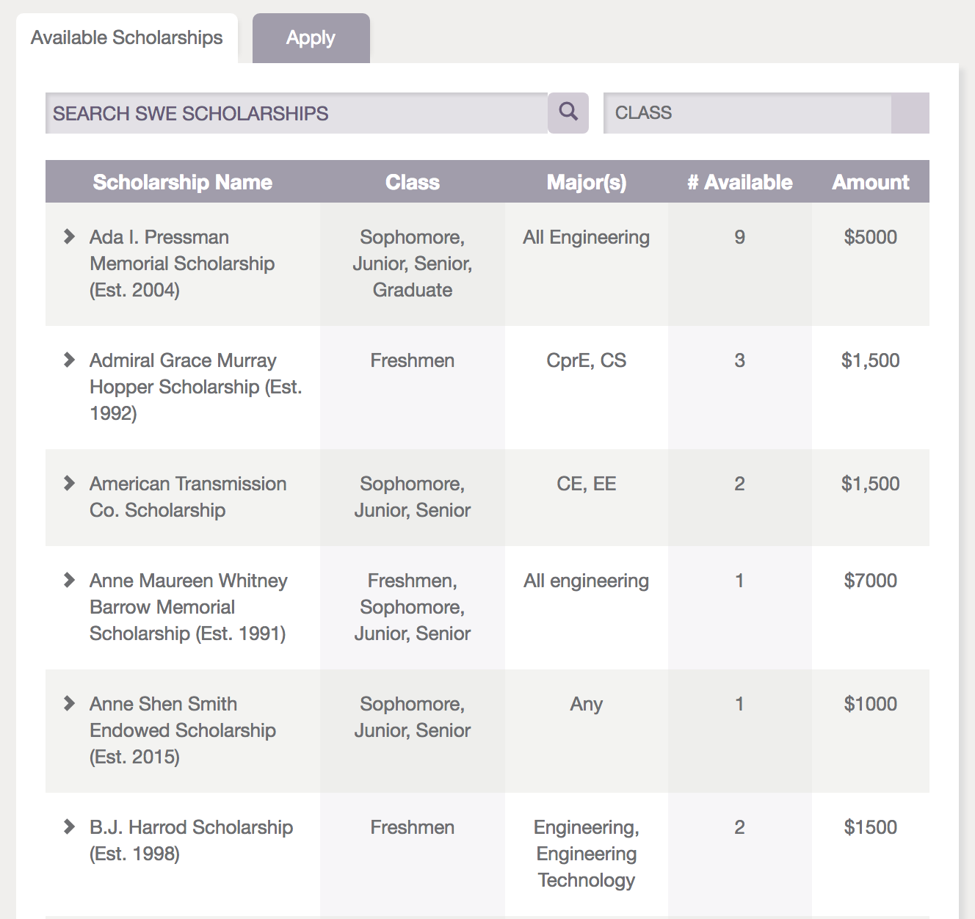

Slide 13
Junior Year
Attend college and financial aid fairs
Narrow down possible career options and investigate the type of education that is needed
Arrange campus visits to those schools that interest your child
Meet with an admissions officer, a financial aid representative, faculty members and college students

Slide 14
Junior Year
Encourage them to obtain officer positions in extracurricular activities they have been involved with
Consider earning college credit while in high school through Dual Enrollment, AP, IB and AICE programs
Schedule to take the ACT and/or SAT in the Spring
Research private scholarship options
Continue to get community service hours

Slide 15
Tests
Colleges require your student to take either standardized test: SAT or ACT
Scores will be needed for each test and are a part of the admission decision
These tests are also important for scholarships and Florida’s Bright Futures Program

Slide 16
Tests
PSAT Sophomore Year
SAT/ACT end of Junior or summer/beginning of Senior Year
Advanced Placement Exams are taken each year at the completion of the AP class
Some consider these exams more difficult than college itself

Slide 17
Senior Year – The Big One!
Take or retake the ACT and/or SAT in the fall
Select the schools to which they will apply and have them make a list of important deadlines for each school
Continue to participate in extracurricular activities, sports, and community service
Have your child create a resume of your academic, athletic and work activities as well as other achievements

Slide 18
Senior Year – The Big One!
Apply and DO NOT wait until just before the deadline
You may need to request a high school transcript
Complete the Free Application for Federal Student Aid (FAFSA) as soon as possible after January 1
You must complete your taxes before submitting the FAFSA
Choose a college and send in any required forms or deposits (housing, meal plan, etc.)

Slide 19
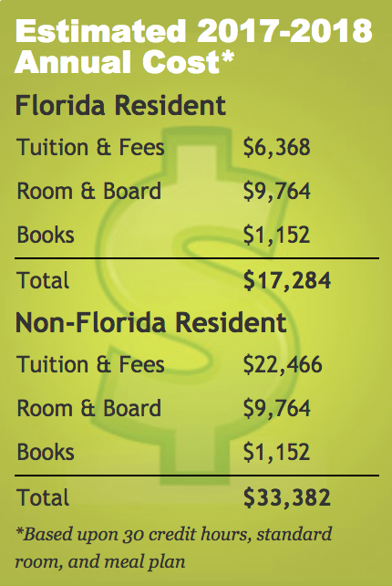
College
Look at their programs, especially if your student is interested in a particular field
Keep in mind the price of tuition, room & board, books, etc.
Average in-state tuition for UCF is $3184 a semester (without room and board)

Slide 20
College
Which colleges are offering scholarships or grants?
What kind of job market supports the college?
UCF has major companies like: Harris, Lockheed Martin, Disney, Universal, Siemens, and Northrop Grumman to support our school
Also look at the availability of College Work Experience Programs

Slide 21
Questions
Questions/Comments?
Information seen in this presentation will be available on the SWE @ UCF website or you can e-mail me if you’d like a copy
Contact Information:
Kelsie McCall (kjmccall@knights.ucf.edu)
Michaela Pain (swe.ucf@gmail.com)

Slide 22


